Slide 1
Quick introduction

Slide 2
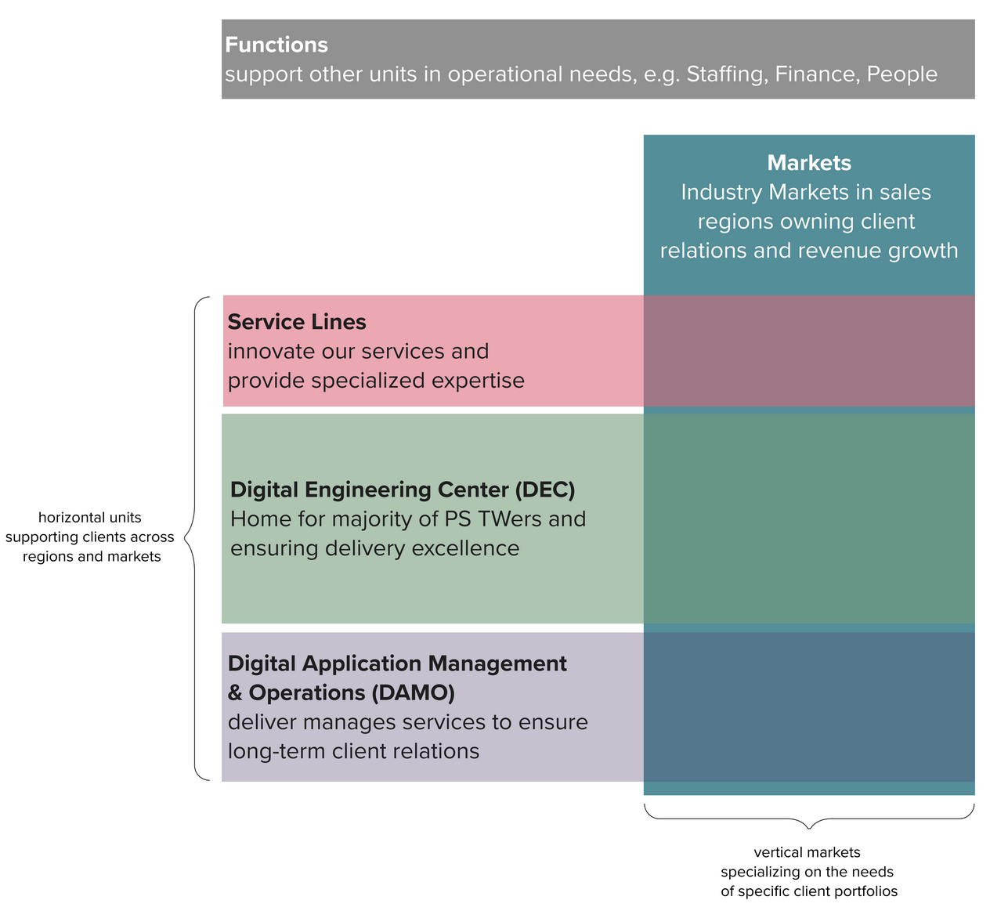
Our organization
Customer experience and product development
Data and AI
Enterprise Modernisation, Platforms and Cloud

Slide 3
Case Study - A modernisation journey for a public sector agency

Slide 4
Context of the client
Client
A government agency that is focused on preventative health
Run programs targeting the whole country
Supporting a spectrum of public and private partners
Problem to solve
Our engagement
Current technologies that power flagship applications cannot scale and is expensive to maintain and run
Client has the vision to be a platform powered organisation to drive their campaigns
Help define the platform roadmap, align stakeholders and demonstrate the new ways of execution to build out the technology platforms to help meet the business objectives
Key Stakeholders:
CIO
Heads of Business Units
Leads of IT and Business teams
Thoughtworks team: 120 people onshore and offshore

Slide 5
We adopted some key sensible defaults to build the platforms for their current needs and future aspirations
Dev sensible defaults
Left-shift security
Mapping out the platform competencies
Evolutionary Architecture Approach
Building right technical foundations
Continuous data migration
Pipeline automation
Self serve data for analytics
Productised design
Scaling agile to build and evolve

Slide 6
Sensible
Defaults
Mapping out the platform competencies
Evolutionary Architecture Approach
Building right technical foundations
Self serve data for analytics
Productised design
Scaling agile to build and evolve
©2022 Thoughtworks Pte Ltd. Commercial in Confidence

Slide 7
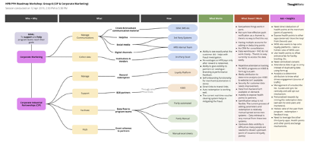
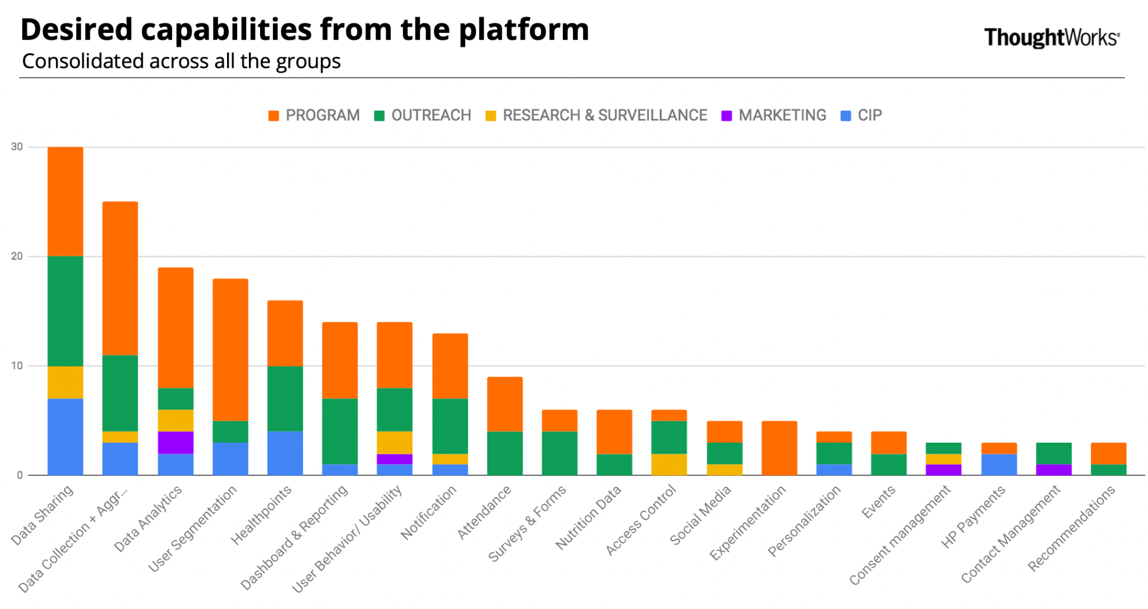
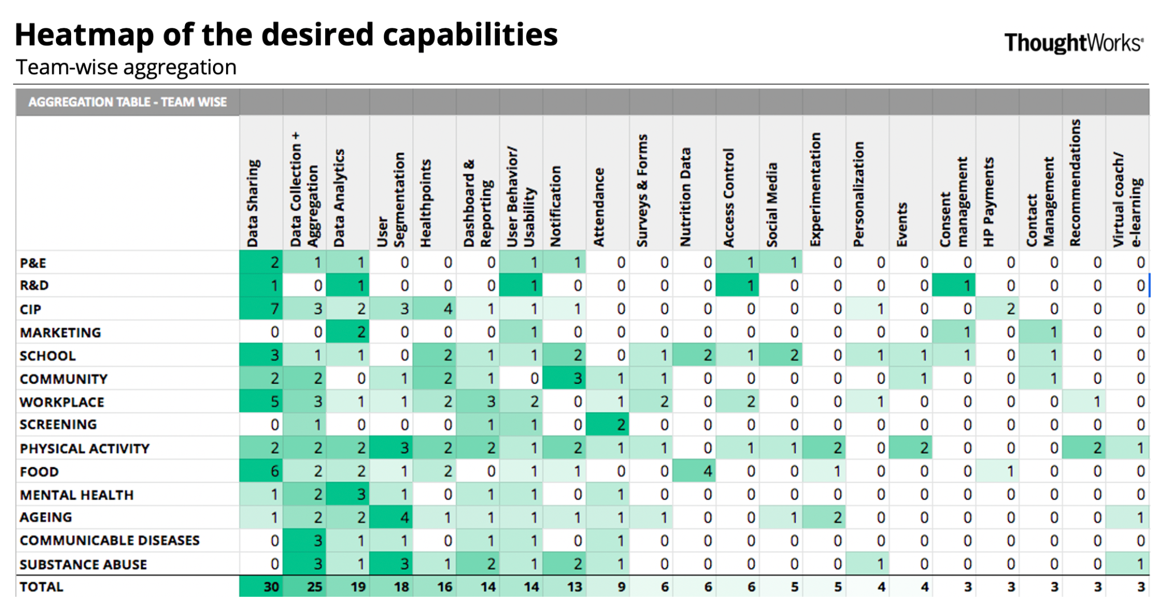
We started with a platform roadmap discovery exercise to map out the business needs and identify core platform capabilities
Key challenges
What we achieved
Client needed a complex platform to be rebuilt to support their ambitious goals including a very popular app with ~1.5M active users. There was no room for failure.
Mapped the needs from all the key business units, to establish the underlying platform and product capabilities needed
Defined the target roadmap for the custom platform - to evolve from the first thin-slice to cutover from the existing application
Multiple stakeholders were already waiting for years, to get their programs into the platform
Aligned all the C-level executives and the senior directors establishing a clear line of sight from strategy to execution
Org. was completely new to agile ways of working and prioritisation was ineffective
Influenced the ways of working, bringing in changes from the environment, processes and the way work was prioritised

Slide 8
Sensible
Defaults
Mapping out the platform competencies
Evolutionary Architecture Approach
Building right technical foundations
Self serve data for analytics
Productised design
Scaling agile to build and evolve
©2022 Thoughtworks Pte Ltd. Commercial in Confidence

Slide 9
De-risking a massive platform refresh by strangulating the monolith and by delivering thin-slices of business value
Platform strategy discovery
Thin-slice 1
Thin-slices 2..n
Modernized Platform
Apps/ E-Services
...
...
App Specific Service (BFF)
Domain Services
Existing Systems
Discover the domain services and workflows
MVPs will be built for high priority workflows, along the way to gradually build up platform with less enhancement / regression to the already built services.
The new platform enabled with domain-specific reusable services will serve all E-Services and Apps.

Slide 10
Microservices Architecture
Illustrative
Microservices is a modular approach to building business applications, which are delivered via small, independent and loosely coupled services
These services are built around business capabilities and they can be deployed by fully automated mechanisms such as DevOps.
New apps or e-services can reuse existing domain services
Reduce the need for coordination among large teams and enable teams to work autonomously
Single source of truth (SSOT) for domain data
Applications are less fragile by using techniques like API versioning and Contract testing
E-Service
Mobile App
Business Admin Portal
External Partner
E-Service BFF
App1 BFF
App2 BFF
...
User
Screening
Appointments
Activity
Loyalty
Notification
IAM
Survey
…
...
Apps / E-Services
App Specific Services
Business Domain Services
NOTE: The services are only examples.
Notes:
KS: Whether many team means many ship accounts.

Slide 11
Sensible
Defaults
Mapping out the platform competencies
Evolutionary Architecture Approach
Building right technical foundations
Self serve data for analytics
Productised design
Scaling agile to build and evolve
©2022 Thoughtworks Pte Ltd. Commercial in Confidence

Slide 12
Introduced Thoughtworks’ sensible defaults to building software and enabled the existing vendor teams
Trunk-based development
Test-driven development (TDD)
Pair programming
Build security in
Fast automated build
Automated deployment pipeline
Early and continuous deployment
Build for production
↑ Deployment Frequency
Helps in accelerating the ‘Four key metrics’ that indicate the performance of a software development team
↓ MTTR
↓ Lead Time for changes
↓ Change Failure Rate

Slide 13


Setting up build pipeline automating the build process and enabling deployment ‘on-demand’
CI Pipeline
Deployment Pipeline
Code Push
Automated verification (where possible) of known acceptance criteria
On-demand deployment triggered by respective owner
Code Reposi-
tory
Static Analysis
Unit Testing
Build
Publish Artifacts
SIT
QA
UAT
PROD
PERF
Lint
SonarQube/Fortify
Secret Scanning
Dependency Vulnerability Check
Code Coverage
Publish deployment artifacts
Docker Image Scanning
API Test
Contract Test
E2E Test
Deploy to respective environments
PROD like config
PROD like config and Security
Uniform Environment and Consistent Configuration using Infra as code
SIT
QA
UAT
PERF
PROD
Automation Testing
Exploratory Testing
Desk Check
User
Acceptance Testing
Performance Testing
Notes:
All engg practices incorporated into the pipeline itself

Slide 14

Shift Security Left - Build Security in
Fortnightly Architecture review with the GovTech Solution Architect to identify security issues early (20+ reviews on the evolutionary architecture before go-live)
IM8 Compatible technical go-live 6 months before the actual release
Multiple internal security audits by Thoughtworks security experts
3 external security audits over a period of one year before go-live (3x VAPT, 3x SSAT, 3x SCR)
Code
Build
Threat Modeling
Security code review via Pairing
SAST
Dependency check
Secrets scan
Security unit test run
Deploy and Release
Security Acceptance criteria
Architecture review
Application threat modeling
Penetration test certification
Automated checks
Access Controls
Server side DOS prevention
Server & data hardening
Monitoring and auditing
Security Testing
Deploy
Automated security checks and access controls
DAST
Security functional testing
Pen testing
Notes:
explain what TW's core security practises are and how they relate to the software delivery lifecycle.

Slide 15
Continuous data migration - Built guardrails to support strangulation and de risk a big bang port-over
Old System
Monolith
Hosted on both cloud and on-prem
Data stored over multiple years (varied data sizes ranging MB - TBs) to be migrated
Sensitive data to be migrated
New System
Microservices with new data structures, each with own DB
New validations and business logic
Old system
Two way sync for some domains
Mostly one-way sync
New system
Continuous data migration
Old system retired

Slide 16
Key success metrics achieved
8 PROD Deployments every month
Prod Deployment is NOT a special event
41 FUNCTIONAL RELEASES in one year
Ability to make quick incremental improvements
20 Domain Services
8 Partner Integrations
100k to 750k
User growth
99th Percentile at 980 ms
(1.5M Requests Tested)
Continuous Performance Testing
10 Squads, 100+ Devs
Ability to scale team
1000+ automated tests
With > 90% code coverage
0
Data Migration Issues after go-live
0
source code review findings by external auditors
Notes:
Performance testing: within 2sec
3 main things:
System scalability
Security and performance

Slide 17
Sensible
Defaults
Mapping out the platform competencies
Evolutionary Architecture Approach
Building right technical foundations
Self serve data for analytics
Productised design
Scaling agile to build and evolve
©2022 Thoughtworks Pte Ltd. Commercial in Confidence

Slide 18




Building a domain oriented data platform to enable self-serve analytics
An evolving, nimble and elastic data hub and exchange platform that will empower
Facilitates easy collection and sharing of health data, primarily lifestyle related, for internal research, program initiatives, as well as external partners
Enables data discovery, linkage for exploration, research, generating insights and business decision making
Protect private entrusted data by robust practices and complying to PDPA and other data protection policies so that PII and sensitive data is not breached or compromised
Comprehensive overarching Data Governance processes that drives data ingestion and consumption.
Secure Data Sharing & Exchange
Decentralised Data Discovery, Linkage & Insights
Data Sovereignty, Privacy & Consent Management
Federated Data Governance

Slide 19
Evolutionary data architecture approach, delivering thin slices of value
Producers
Acquisition
Raw Store
Process/Analyze
Govern & Share
Consumers
Existing Data Warehouse
Change Data Capture
Row Storage
Experimentation Zone/
Sandbox
Customized
Reporting Apps
Non
PII
Data Marts
Dashboards
Semi-Structured Data
ETL Batch Processing
Preprocessing
Data Virtualization
Data Cleansing
Data
Standardisation
Data Enrichment
Data Discovery
Columnar Data/File Storage
Structured Data
Data
Anonymisation
Archive
Insight Products
PII
Data Validation
Privacy Preserving Data Linkage
Data Hub
PII Store
Data Release to internal and external partners
Re-identification
Platform Capabilities
Data Governance
Access Control
Data Lineage
Data Retention
Data Catalog
Monitoring & Alerting
Log Management
Secrets Management
Workflow Management
Encryption
Data Auditability
And More

Slide 20











Adopting Data Mesh principles to deliver more value for analytical use cases
Enterprise Governance & Open Standards
Enable interoperability
Domain data owned & served by cross-functional teams
New Consumption oriented Analytical domains can be created correlating data from other domains
Discoverable
Addressable
Self-describing
Domain’s internal data pipeline uses common self-serve data infra facilitated by the data platform
Domain oriented data served as a product for any other domain to use
Secure (governed by global access control)
Trustworthy
Interoperable (governed by open standard)
Data Platform engineers
Self-serve Data and ML Infra as a Platform
Control plane (policy enforcement, discovery),
Infra (Storage, pipeline, catalogue, access control, etc)
Analytical plane (Machine learning Ops and Infrastructure)
Delivery Infrastructure
‹#›
Notes:
Call out the next steps wh

Slide 21
Deriving business value: Closing the feedback loop
Consumer Teams
Batch and Stream based ingestion
Consumption via analytic tools or API or file based
Data source 1
Data source 2
…
Data Platform
External Partners
Internal Research Team
Business Platform
Data driven business insights

Slide 22
Self-serve data for analytics: key success metrics achieved
~ 95%
Re-identification risk reduction
3 Weeks to few minutes
Reduction in user onboarding process
Few months to few days
Reduction in data onboarding process
Few seconds
For end users to get a 360’ view
10+ Billion anonymized records available for self-serve analytics
Privacy preserving linkage to link between anonymized citizen records
10x
Growth in producers and consumers
5x
Partner integrations
Compliance as code
Implemented to ensure adherence to IM8 and PDPA guidelines in an automated way
Notes:
Performance testing: within 2sec
3 main things:
System scalability
Security and performance

Slide 23
Sensible
Defaults
Mapping out the platform competencies
Evolutionary Architecture Approach
Building right technical foundations
Self serve data for analytics
Productised design
Scaling agile to build and evolve
©2022 Thoughtworks Pte Ltd. Commercial in Confidence

Slide 24
Marrying the old and the new
Visioning
Strategic Vision | Product Roadmap
Core Experience Redesign
Legacy Modernisation
…
Foundation to accelerate delivery
Continuous Discovery
Scale existing business/capabilities
New lines of business
Organisational Transformation
0
3
6
9
12
18
24
Months
Notes:
Various role functions have overlaps in terms of functionalities and impact on each other
Inefficiencies in one of the functions impact other functions as well
Problems in the system are complex and spread over to different aspects of tech, data as well as design.
In order to effectively and efficiently fix a part of the system, multi-dimensional approach is needed that calls for cross-functional teams covering tech, data and design aspects
For instance, fixing the data parsing and correction stage calls for a joint data+design approach
It’s about finding the simplest and the most effective solution .
Building a modern digital business requires putting a lens on specific outcomes but also calls for attention towards higher level areas such as delivery excellence, exploring new business frontiers, scaling innovation and setting a path for organisational transformation. The journey that we propose takes these various tracks into consideration to enable a business that’s inspiring, responsive, resilient and drives customer delight.
-----
More for enterprise modernisation .
Need to run different tracks.
We believe in EMPC. We need to move to make it effective.
Don’t try to boil the ocean on everything at once.
Don’t just go down one of the tracks.
Clean up foundation practices to accelerate delivery - e.g. putting out microservices, taking out, cleaning up the data, move things to cloud. To continually accelerate the entire process.
You will be missing out on some of the other tracks.
Is lift and shift everything the best choice?

Slide 25
Marrying the old and the new
Visioning
Strategic Vision | Product Roadmap
Core Experience Redesign
Legacy Modernisation
…
Foundation to accelerate delivery
Continuous Discovery
Scale existing business/capabilities
New lines of business
Organisational Transformation
0
3
6
9
12
18
24
Months
Notes:
Various role functions have overlaps in terms of functionalities and impact on each other
Inefficiencies in one of the functions impact other functions as well
Problems in the system are complex and spread over to different aspects of tech, data as well as design.
In order to effectively and efficiently fix a part of the system, multi-dimensional approach is needed that calls for cross-functional teams covering tech, data and design aspects
For instance, fixing the data parsing and correction stage calls for a joint data+design approach
It’s about finding the simplest and the most effective solution .
Building a modern digital business requires putting a lens on specific outcomes but also calls for attention towards higher level areas such as delivery excellence, exploring new business frontiers, scaling innovation and setting a path for organisational transformation. The journey that we propose takes these various tracks into consideration to enable a business that’s inspiring, responsive, resilient and drives customer delight.
-----
More for enterprise modernisation .
Need to run different tracks.
We believe in EMPC. We need to move to make it effective.
Don’t try to boil the ocean on everything at once.
Don’t just go down one of the tracks.
Clean up foundation practices to accelerate delivery - e.g. putting out microservices, taking out, cleaning up the data, move things to cloud. To continually accelerate the entire process.
You will be missing out on some of the other tracks.
Is lift and shift everything the best choice?

Slide 26
The most successful Product Teams
Balance strategy, design and technology excellence
Define strategy
Understand why and define how
Execute solution
Create the outcome
Build the right thing
with lean product development
Discover
Define
Design
Build
Measure
Learn
Deliver
Build the thing right
via continuous integration and delivery
Notes:
This is our process - to build the right thing, and build it right
How we think…
We’re passionate about making strategy adaptive and joining it up with execution.
Strategy is about understanding customer value and needs, and defining a first expression of a vision and plan to enable teams to start. Execution is where we test our assumptions and refine the strategy and plan to deliver on the outcomes
Design Thinking is how we explore and solve problems;
Lean is our framework for testing our beliefs and learning our way to the right outcomes; it’s how we build the right things
Agile is how we adapt to changing conditions with software; that’s how we build things right.

Slide 27
Dual Track Approach
Continuous Discovery
Delivery & Continuous Discovery
EXPERIMENT
Low-cost
Our dual track approach means we can build, measure and learn based on insight and data, getting continuous feedback and insight to inform our product strategy.
Discovery stream focuses on de-risking assumptions, increasing confidence in product market fit. This stream evolves the product strategy and roadmap for the delivery stream, based on the insight and feedback from real customers and use cases. This quick feedback allows us to ensure we’re truly meeting customer needs, and enables us to pivot early if required.
Delivery stream is focused on delivering the functionality to drive towards outcomes defined.
OBSERVATION
Based on research/ exploratory analysis
DISCOVERY HYPOTHESIS
Based on measurable signals
MEASURE
Against measurable signals
LEARN
BUILD
FEATURE BACKLOG
BUILD HYPOTHESIS
Based on measurable signals
MEASURE
Against measurable signals
LEARN
Continuous Delivery
Notes:
Post inception, we propose a dual track approach to hit the milestone of your Q4 release. One track is Continuous Discovery, and the other is Continuous Delivery of the MVP.
First, let’s look at the Continuous Discovery track
When we think about the essential parts of launching a product, you need to be confident in the product desirability, viability and feasibility. Often the desirability and viability are the most ambiguous and fuzzy. For this reason, we have a Continuous Discovery track runs in parallel, focusing in on the desirability and viability of this digital bank.
This team is driving the product strategy, doing user/market research, de-risking assumptions, and narrowing in on a clear Unique Selling Proposition, to stand out among the other banks launching at the same timeframe.
They focus on moving from Minimum Viable Product, to Minimum Lovable Product.

Slide 28
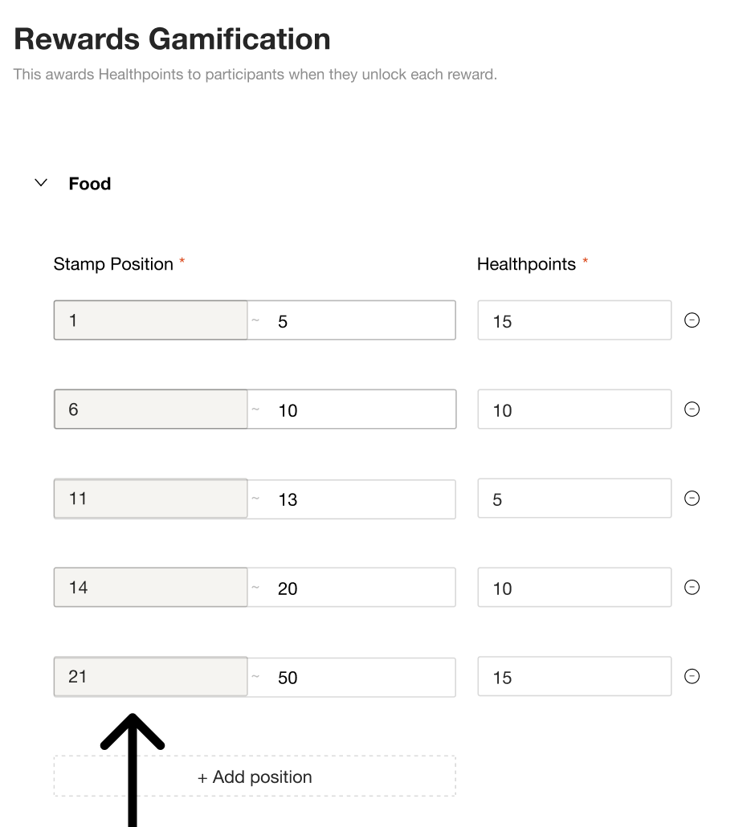
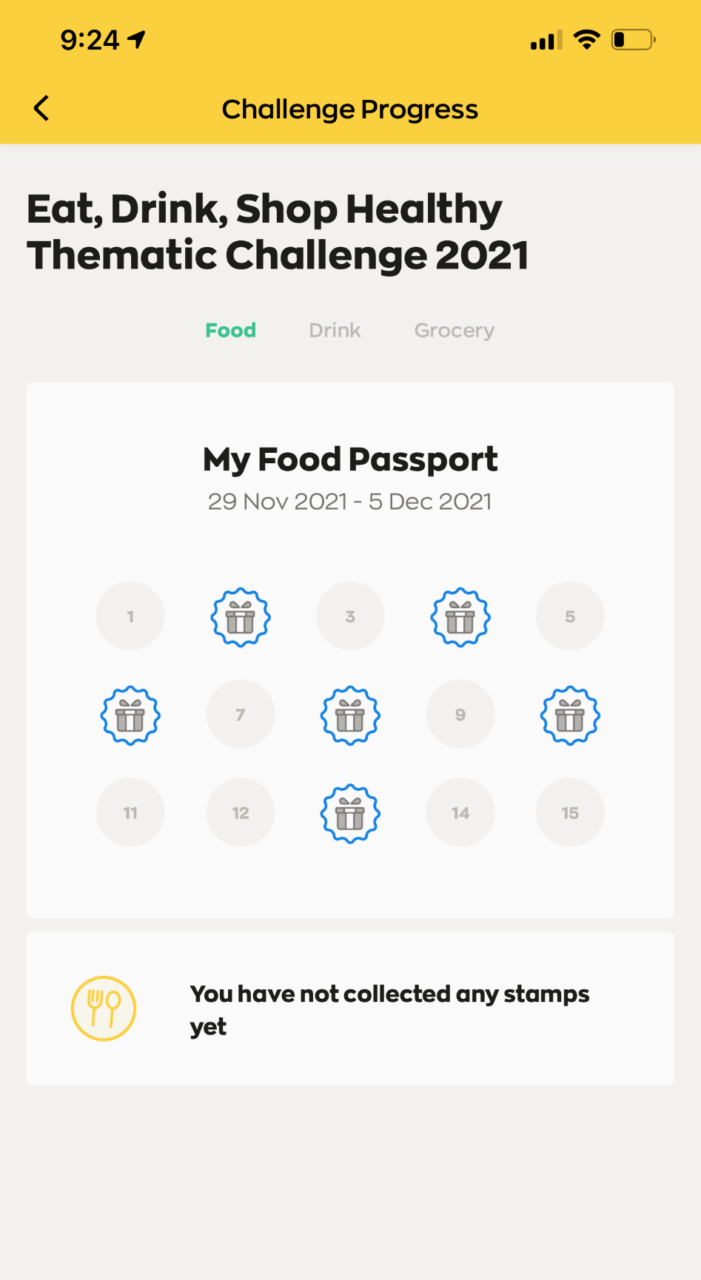
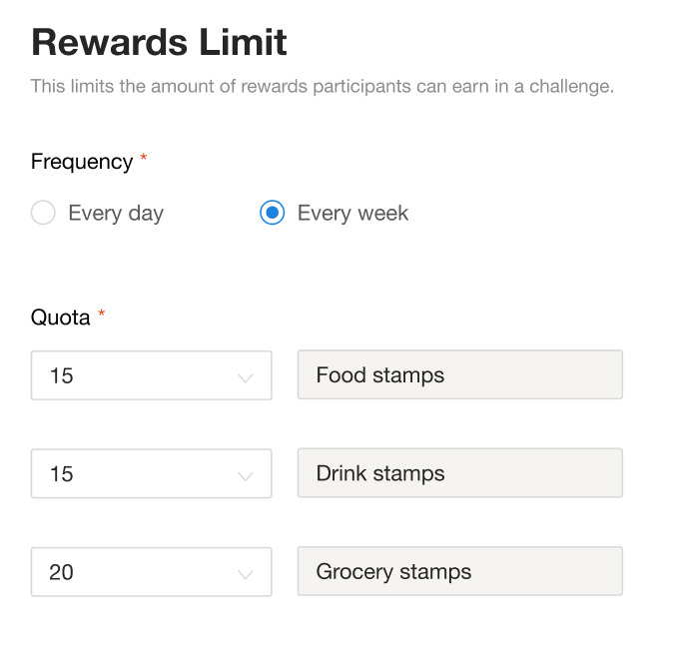
Productized challenges give business users autonomy and flexibility to spin up new challenges
Business users can now configure a challenge by setting the metrics to track and rewards to give to the public, without additional development effort.

Slide 29
Sensible
Defaults
Mapping out the platform competencies
Evolutionary Architecture Approach
Building right technical foundations
Self serve data for analytics
Productised design
Scaling agile to build and evolve
©2022 Thoughtworks Pte Ltd. Commercial in Confidence

Slide 30
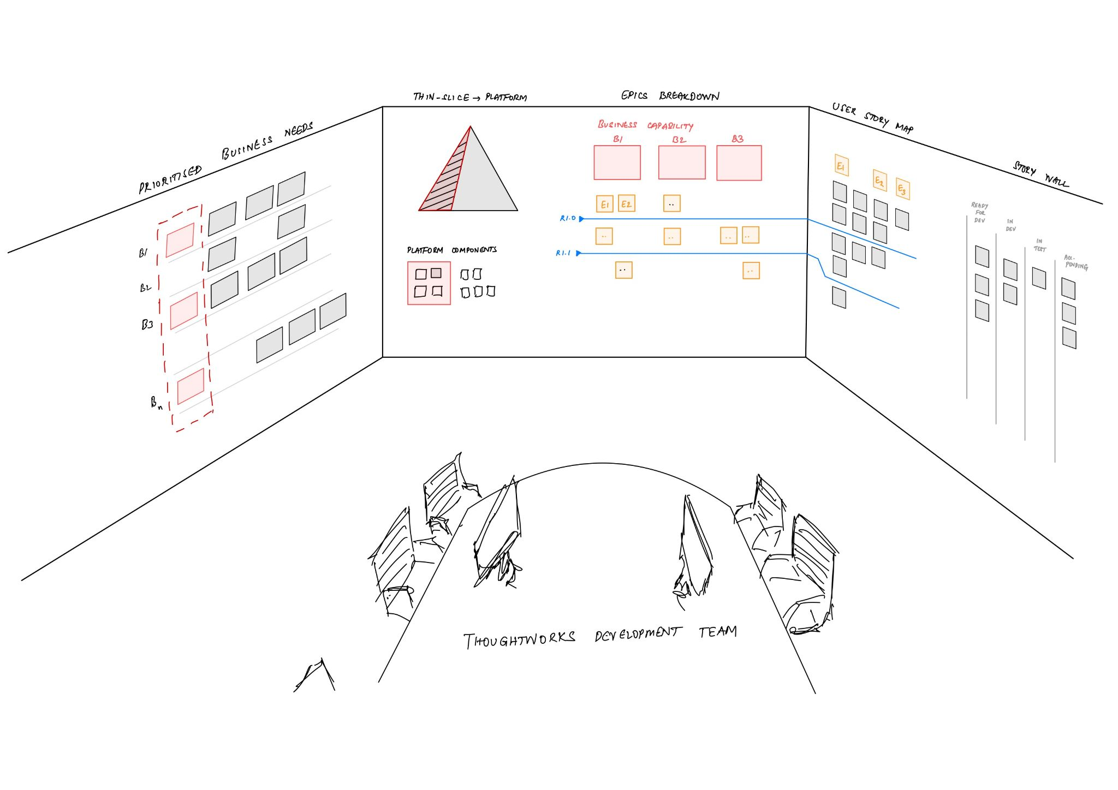
By establishing the line of sight for transparency, alignment and faster decision making
2
3
1
4
5

Slide 31
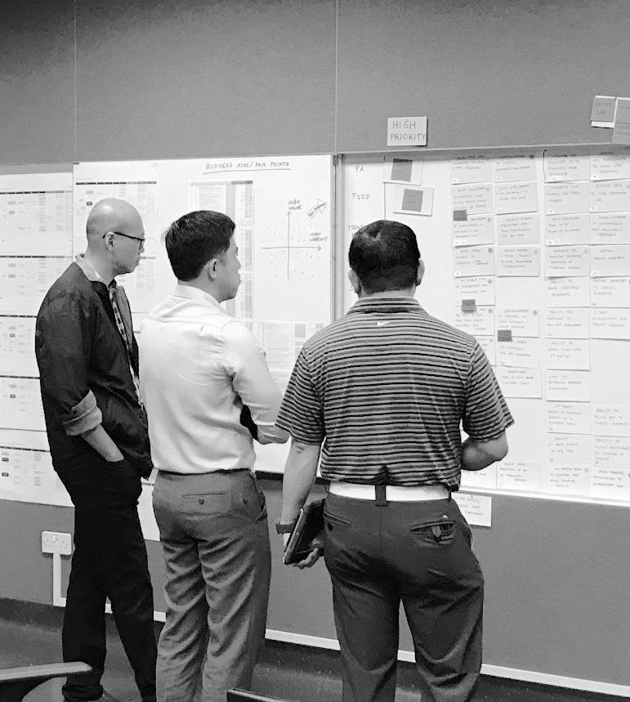
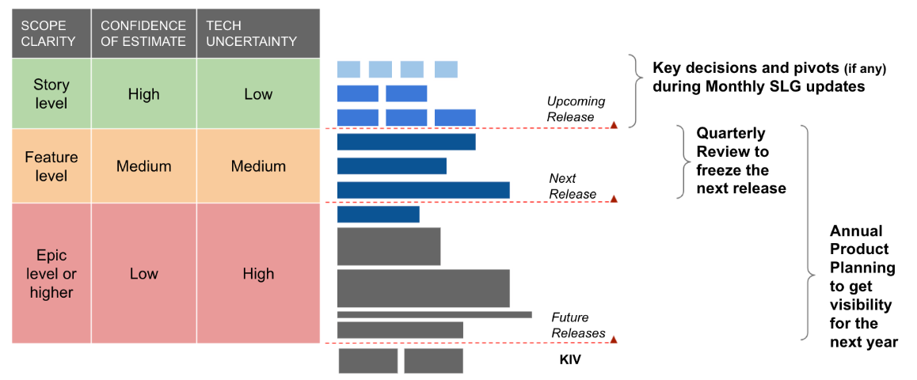
Influenced the ways of working and planning
Shifting from big annual planning to forced prioritisation based on capacity
Trade-offs between business vs. business
Fast-feedback led development cycles
And more…

Slide 32
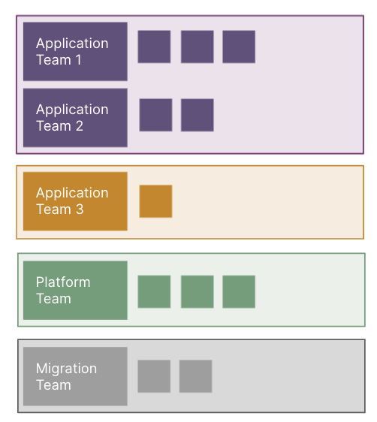
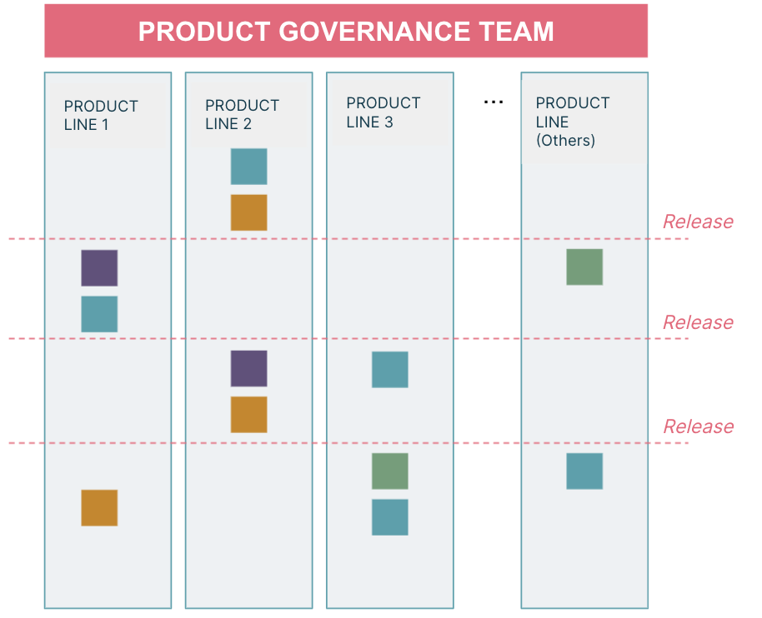
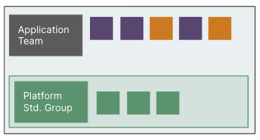
By evolving Team structures and practices at run time, without any disruption
YEAR 1:
Small team to set the platform foundation
YEAR 2:
Rapid ramp-up to achieve a launch target
YEAR 3:
Consolidation and restructuring post public launch
TEAM SIZE
MVP Team with the focus on setting the base components for the identified thin-slice
Application centred teams focusing on speed to accommodate the change in thin-slice direction
Fully flexible product lines to accelerate parallel execution for multiple BUs

Slide 33

Other Case Studies
Notes:
10 min

Slide 34
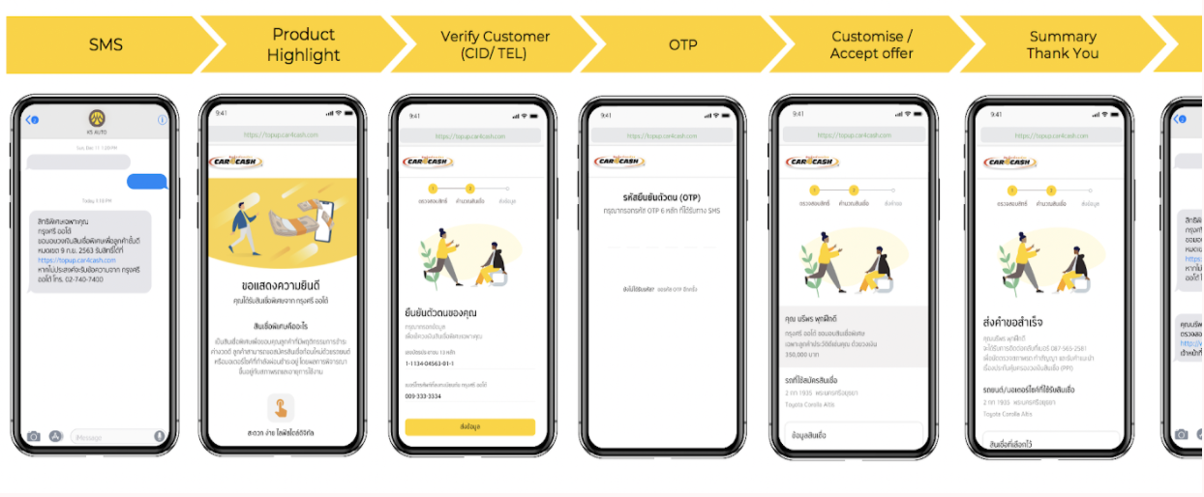
DIGITAL LOAN TOP UP
LEGACY MODERNISATION
FOR A MAJOR AUTO FINANCE COMPANY IN THAILAND
The Thin Slice - Top up Product
For an existing customer with good credit, who needs cash urgently for personal or business needs for an amount larger than a personal loan, the Digital Top up is a self service online tool that supports a simplified digital end to end process & offering of flexible loan terms unlike the current telesales process with low conversion rate.
Transformation by enablement and legacy modernisation along with product MVP delivery
The Thin Slice Transformation Approach
Designed to show the client the realistic potential of delivering business outcomes while the organisation gears to operate with speed, responsiveness and agility.
The TW transformation team did a collaborative workshop with the executives to identify and prioritize a list of thin slices of business capabilities. The first prioritised Thin Slice was Top Up business capability.
‹#›
Notes:
Case study details: https://docs.google.com/document/d/1dgNRmeSK-qGdzPxOa97Zp6z4Xt4yLrUQchbdGkcDWqs/edit
Project Context
Krungsri Auto (KA) is Thailand’s largest auto finance company with USD 16Bn in assets, >3500 employees and >2Mn customers across the country. Coming from a traditional delivery model, they partnered with ThoughtWorks to kick start their transformation journey by modernising their digital business to build a delightful car drivers ecosystem and steer ahead of their competitors.
Krungsri Auto had initially engaged with ThoughtWorks on a 12 month digital transformation advisory gig. To demonstrate how Krungsri Auto could deliver business outcomes while the organisation gears to operate with speed, responsiveness and agility, we proposed thin slices of delivery work to spawn from the advisory work with the Top Up product being the first one to be delivered.
Business outcome
Product Transformation
Top up of existing loans is a major cash cow offering where existing customers with a 18 month good credit history were given loans up to 150% LTV based on value of the car.
Previously, customer service executives would reach out to qualified customers by phone, offering this product. This suffered from scaling problems (customer service was only able to cover 25% of eligible customers each month) and low conversion rate (customers less open for the product on cold calls).
By automating this process, the new Top Up product allows KA to reach out to 100% of eligible customers, reduce operational costs and give more convenience and a better experience to their customers.
Shereen’ notes for business context:
Top up is an auto loan lending product for existing good loan customers, that provides additional top up(principal) for a special interest rate. In the traditional model of telesales calling, the number of top up leads they were reaching out to was 2-3% percent of the potential customer base. The low conversion rate was mainly because of the manual telesales process and limited capacity that was used to reach out to customers. So the primary pain point that was picked to address was the ability to reach out to more potential customers as soon they become eligible for Top up.
On further TW discovery/inception, looking at the business model holistically, there were many opportunities identified that can be leveraged to improve the overall revenue from the top up product. The other opportunities identified were improvements in the overall process of lead generation, lead acquisition and loan disbursement process.
For MVP release what was built was
Digital web app where customers can view their top up offer and loan information.
Digital platform and legacy modernisation, exposing business capabilities related to Top up from legacy systems like AS400.

Slide 35
DIGITAL LOAN TOP UP - LEGACY MODERNISATION
What we did:
Digital web app where customers can view their top up offer and loan information.
Digital platform and legacy modernisation, exposing business capabilities related to Top up from legacy systems like AS400.
Solution:
Cross-functional product teams of TWers and client engineers to deliver modern technologies for a new platform
Leverage the Cloud and rely on Domain Driven Design and Change Data Capture to establish a new API platform to expose reusable business capabilities (especially from AS400)
AS400 would serve as a source of events that could be consumed by a set of modern, cloud-based microservices.
Microservices would offer business capabilities in a clean, domain-driven API and could be consumed by a variety of client-facing applications or other business processes.
Hardened infrastructure and secure application standards
Loan decision
Manual/
Monthly
Automated/
Realtime
Customer reach
25%
100%
AS400 dependent, expensive, slow
Scalable and Reusable Microservices, API enabled architecture on the cloud
Technologies used:
AWS (MSK, EKS, Cognito, Aurora, API Gateway, Transit Gateway, Fargate, WAF, KMS, S3)
Attunity Replicate
CloudGuard Dome9
Terraform
DataDog, PagerDuty
Technology capability
Team capability
Groundwork was laid for the client team to not only be effective in continuing the products evolution but be change champions in the overall transformation program

Slide 36

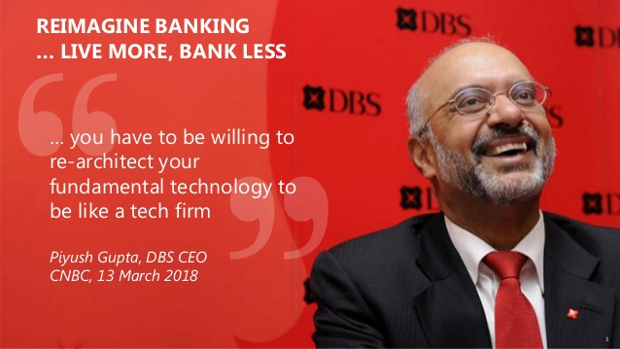
Modernise legacy applications to improve their architecture, technology, capabilities and also reduce cost overheads
Background
The bank is at the forefront of leveraging digital technology to shape the future of banking, having been named “World’s Best Digital Bank” by Euromoney. In addition, DBS has been accorded the “Safest Bank in Asia” award by Global Finance for ten consecutive years from 2009 to 2018.
We Delivered
The legacy app was almost a decade old, and a lot of performance issues were identified, ThoughtWorks works with clients to deliver a new application and backend platform, with the following benefits:
Not tied to the project, we made a program level impact with a platform-wide strategy
Consolidated other legacy systems, where possible
Enabled cost savings by adopting newer technologies
Added/improved on existing features (Customer Research Driven)
Continuous production releases (every ~2 sprints)
Reusing of code / UI components from other systems / programs
Created a 360 degree customer accounts view by integrating with open banking APIs
Improved testing practices
Deployed to the cloud instead of self-managed servers
Improved deployment practices (Legacy —> CI/CD Pipelines)
Notes:
Case study details: https://docs.google.com/document/d/1vrPY_TICj1tU-btr2TbTqRguT6_yQvwgFDjR8ud5_54/edit
large-scale program that spreads across multiple projects. The objective is to modernise legacy applications with modern applications to improve their architecture, technology, capabilities and also reduce cost overheads.
Project: Your Financial Journey
Your Financial Journey is an application that Relationship Managers use to manage their clients assets and liabilities, in order to advise their high net worth clients on their current position and cross-sell additional products to increase their net wealth, investments and/or protection coverage.
The impact that ThoughtWorks created
The legacy app was almost a decade old, and a lot of performance issues were identified
Enabled cost savings by adopting newer technologies
Deployed to the cloud instead of self-managed servers
Improved deployment practices (Legacy —> CI/CD Pipelines)
Added/improved on existing features (Customer Research Driven)
Consolidated other legacy systems, where possible
Improved testing practices
With the current pandemic, sales figures have dropped and hence provided RMs with the tools / features that assist in improving their productivity and sales
Continuous production releases (every ~2 sprints)
Not tied to the project, we made a program level impact with a platform-wide strategy
Reusing of code / UI components from other systems / programs
Created a 360 degree customer accounts view by integrating with open banking APIs

Slide 37
We look forward to working with you
Jayesh Ghatge
Business Development Director
Jayeshg@thoughtworks.com

